Slide 1
Python – How to code a program?
Premanand S

Slide 2
Different approach to run Python programme!
Python command prompt
Command prompt or Anaconda command prompt window
Text editor – Notepad and command prompt
Anaconda IDE / Pycharm
Google Colab

Slide 3
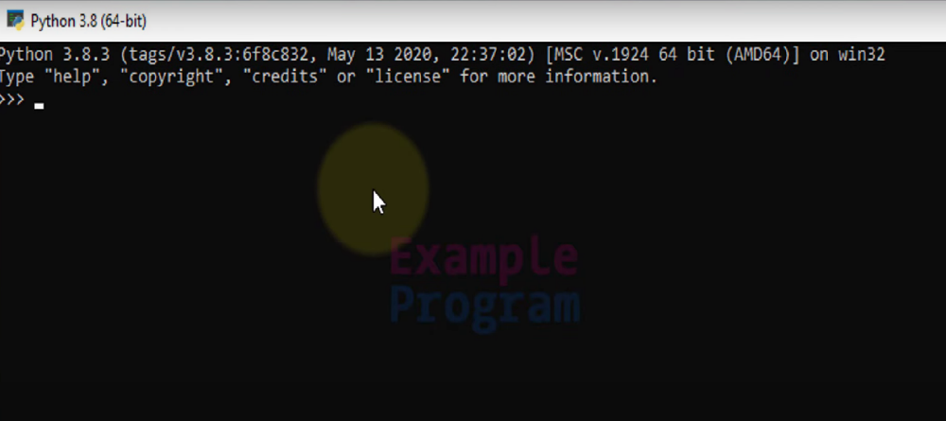
Python command prompt
www.python.org
Open python command prompt

Slide 4
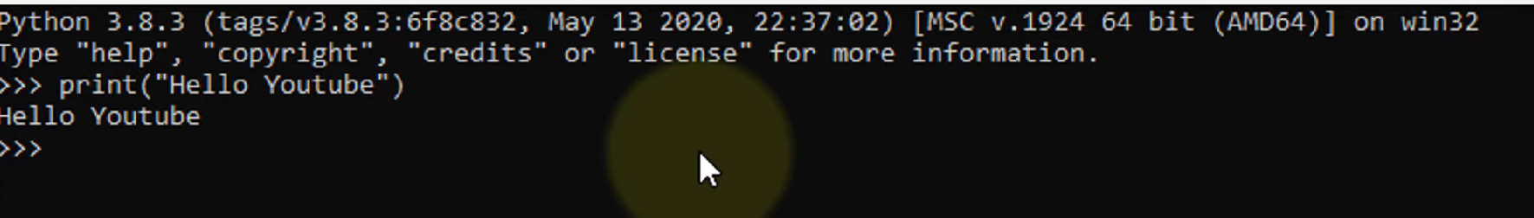
Python command prompt

